Slide 1
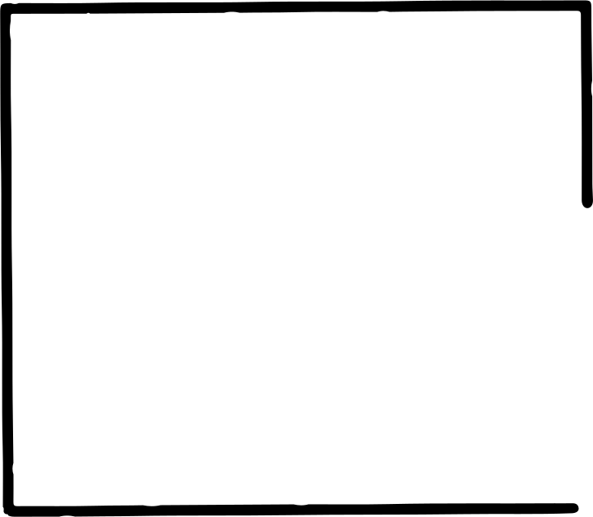
ARRAY IN VB

Slide 2

WHAT IS AN ARRAY?
  A collection of elements of the same type stored in sequence.
  Accessed using an index (0-based).
  Useful for handling lists, tables, and bulk data.

Slide 3
DECLARING & ALLOCATING ARRAYS
  Declaration: tells the program what type of data to store.
  Example: Dim numbers(4) As Integer
  Allocation: reserves memory for elements.
  Arrays have a fixed size once declared.

Slide 4
INITIALIZING ARRAYS
Static Initialization:
Dim grades() As Integer = {85, 90, 78}
Dynamic Initialization:
grades(0) = 85
grades(1) = 90
Always check the index to avoid errors.

Slide 5
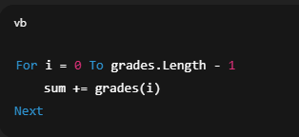
TRAVERSING ARRAYS
  Use loops to access all elements.
  Example (sum all values):

Slide 6
SORTING ARRAYS
  Purpose: arrange elements in order.
  Manual methods: Bubble Sort, Selection Sort.
  Built-in methods: Array.Sort(array)
  Sorting improves search efficiency.

Slide 7
KEY TAKEAWAYS
✔ Arrays store multiple values under one variable name.
✔ Elements are accessed with indices.
✔ Traversal is needed for calculations.
✔ Sorting + searching makes data meaningful.
✔ Arrays = foundation for advanced data structures.

